Slide 1

SQL - Final Project
Sales Performance Analysis of Walmart Stores using Advanced MySQL Techniques

Slide 2
Q1. Identifying the Top Branch by Sales Growth Rate Walmart wants to identify which branch has exhibited the highest sales growth over time. Analyze the total sales for each branch and compare the growth rate across months to find the top performer.
Solution:
WITH step1 AS (
SELECT
branch,
DATE_FORMAT(date, '%m') AS month,
round(SUM(total),0) AS total_Sales
FROM
walmart_sales
GROUP BY
branch, month
),
Cont:
step2 AS (
SELECT
branch,
month,
total_sales,
LAG(total_sales) OVER (PARTITION BY branch ORDER BY month asc) AS previous_month_total,
((total_sales - LAG(total_sales) OVER (PARTITION BY branch ORDER BY month asc)) / LAG(total_sales) OVER (PARTITION BY branch ORDER BY month asc)) * 100 AS growth_diff
FROM
step1)
Cont:
SELECT
branch,
month,
round(AVG(growth_diff),2) AS percentage_growth_rate
FROM
step2
GROUP BY
branch,month
ORDER BY
percentage_growth_rate DESC
limit 1;

Slide 3
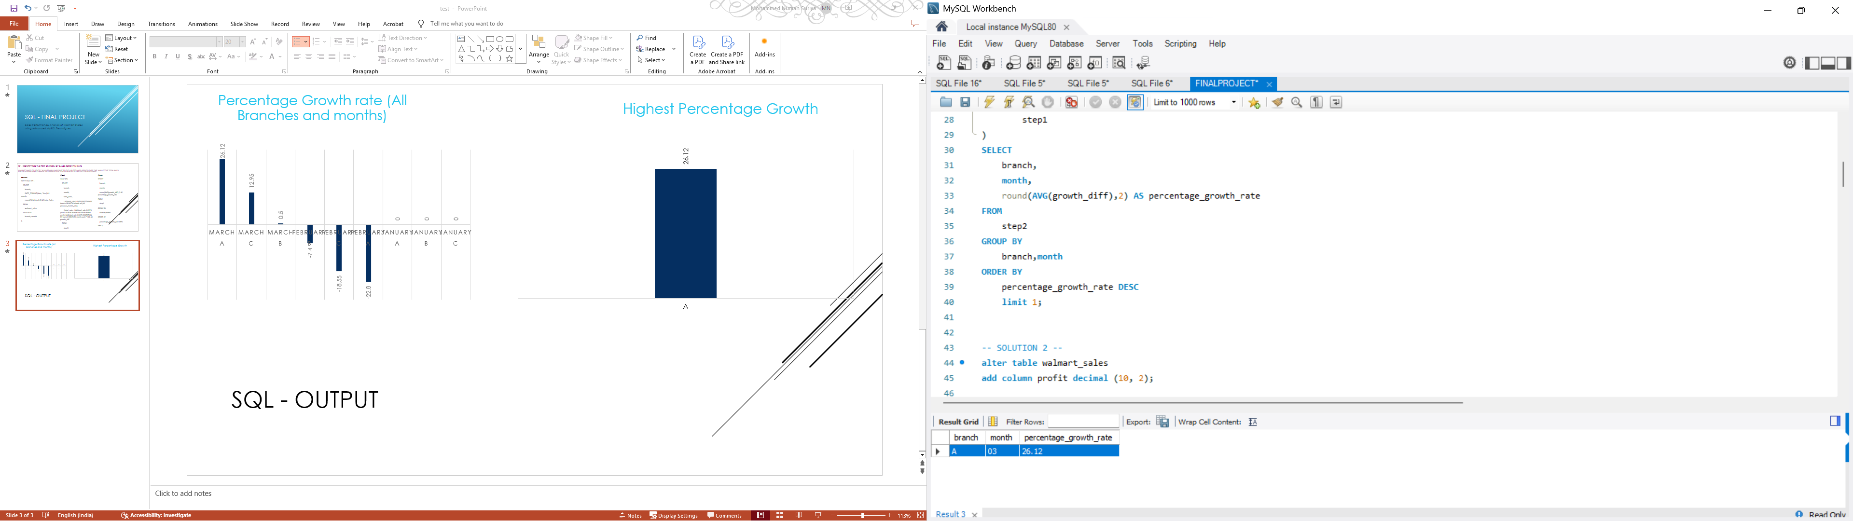
SQL - Output
Percentage Growth rate (All Branches and months)
Highest Percentage Growth

Slide 4
Q2. Finding the most profitable product line for each branch Walmart needs to determine which product line contributes the highest profit to each branch. The profit margin should be calculated based on the difference between the gross income and cost of goods sold
Solution:
alter table walmart_sales
add column profit decimal (10, 2);
update walmart_sales
set profit = cogs-`gross income`;
WITH CTE_HighestProfitProduct AS (
SELECT
Branch,
`Product line`,
round(SUM(PROFIT),0) AS TOTAL_PROFIT,
RANK() OVER (PARTITION BY Branch ORDER BY SUM(PROFIT) DESC) AS Rank_TOP
Cont
FROM
walmart_sales
GROUP BY
Branch,
`Product line`
)
SELECT
Branch,
`Product line`,
TOTAL_PROFIT
FROM
CTE_HighestProfitProduct
WHERE
Rank_top<2
ORDER BY TOTAL_PROFIT DESC;

Slide 5
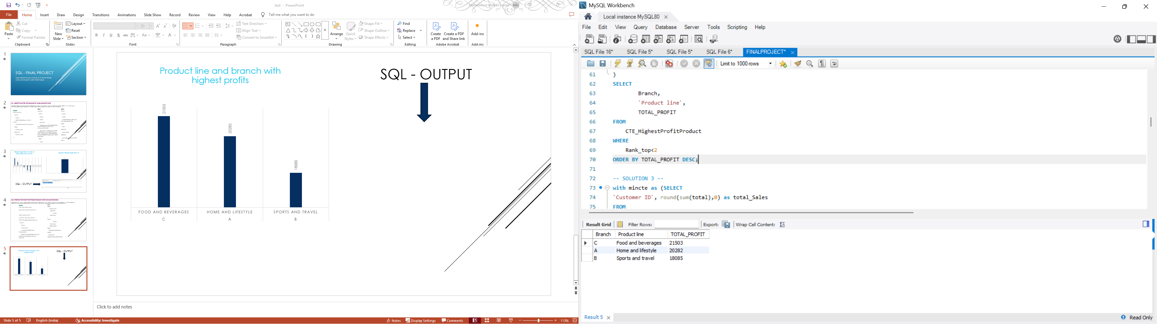
SQL - Output
Product line and branch with highest profits

Slide 6
Q3. analyzing customer segmentation based on spending Walmart wants to segment customers based on their average spending behavior. Classify customers into three tiers: high, medium and low spenders based on their total purchase amounts
Solution:
with mincte as (
SELECT
`Customer ID`,
round(sum(total),0) as total_Sales
FROM
WALMART_SALES
group by `Customer ID`
)
Cont
select `Customer ID`,
case
when total_sales <21531 then 'Low Spender'
when total_Sales between 21532 and 24000 then 'Medium Spender'
else 'High Spender'
end as Spender_category
from
mincte
order by
spender_category;

Slide 7
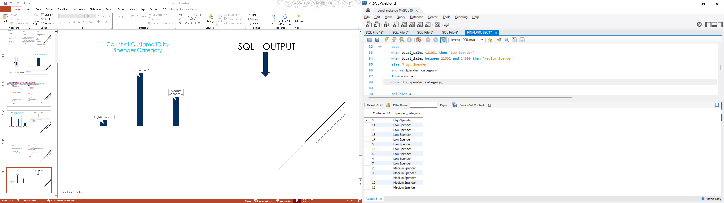
SQL - Output
Count of CustomerID by Spender Category

Slide 8
Q4. Detecting anomalies in sales transactions Walmart suspects that some transactions have unusually high or low sales compared to the average for the product line. Identify these anomalies
Solution:
with avg_sale as (
select
`Product line`,
round(avg(total),2) as avg_sales
from walmart_sales
group by `Product line`),
find_anomaly as (
select
`Customer ID`,
`Product line`,
Total,
avg_sales,
Cont
case
when total>(avg_sales*1.5) then 'High Anomaly'
when total>(avg_sales*0.5) then 'Low Anomaly'
else 'No anomaly'
end as 'type_of_anomaly'
from
walmart_sales
join avg_sale using (`Product line`))
Cont
select
`Customer ID`,
`Product line`,
round(Total,2) as total,
avg_sales,
type_of_anomaly
from
find_anomaly
order by
type_of_anomaly desc;

Slide 9
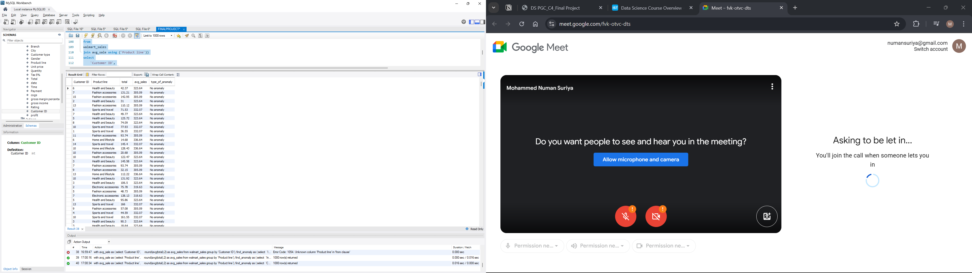


SQL - Output

Slide 10
Q5. Most Popular Payment Method By CITY Walmart NEEDS TO DETERMINE THE MOST POPULAR PAYMENT METHOD IN EACH CITY TO TAILOR MARKETING STRATEGIES
Solution:
SELECT
city,
Payment,
count_total
FROM (
SELECT
city,
Payment,
COUNT(*) AS count_total,
RANK() OVER (PARTITION BY city ORDER BY COUNT(*) DESC) AS pay_rank
FROM
Cont
walmart_sales
GROUP BY
city, Payment
)
AS top_payments
WHERE
pay_rank = 1
order by
count_total desc;

Slide 11
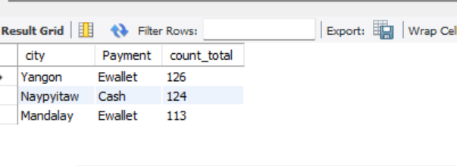
SQL - Output
Most Popular payment method in each city

Slide 12
Q6. Monthly Sales distribution by gender Walmart wants to understand the sales distribution between male and female customers on a monthly basis
Solution:
SELECT
MONTHNAME(date) AS month_total,
gender,
ROUND(SUM(total), 2) AS total_sales
FROM
walmart_sales
GROUP BY gender , month_total
ORDER BY gender , total_sales DESC;

Slide 13
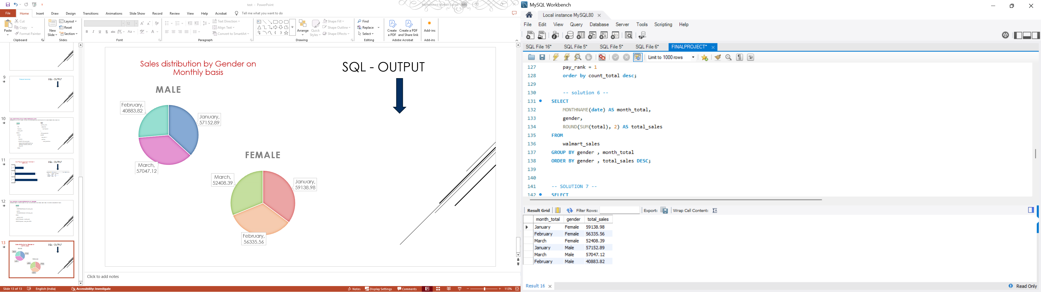
SQL - Output
Sales distribution by Gender on Monthly basis

Slide 14
Q7. Best product line by customer type Walmart wants to know which product lines are preferred by different customer types (Member VS normal)
Solution:
SELECT
`Customer type`,
`Product line`,
COUNT(`Product line`) AS NUMBER_OF_SALES
FROM
walmart_sales
GROUP BY `Customer type` , `Product line`;

Slide 15
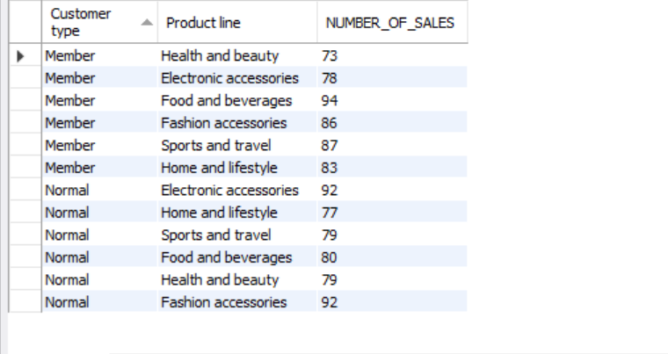
SQL - Output
Preferred Product line by Customers (Normal vs Member)

Slide 16
Q8. identifying repeat customers Walmart needs to identify customers who made repeat purchases within a specific time frame (e.g., within 30 days)
Solution:
SELECT
`Customer ID`, COUNT(`Customer ID`) AS no_of_repeat_orders
FROM
walmart_SALES
WHERE
date BETWEEN '2019-01-01' AND '2019-01-31'
GROUP BY
`Customer ID`
HAVING COUNT(DISTINCT date) > 1
ORDER BY
no_of_repeat_orders DESC;

Slide 17
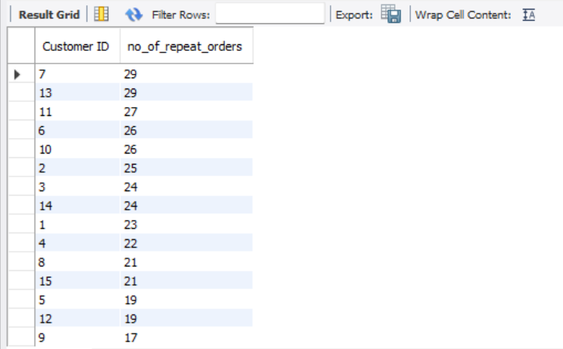
SQL - Output
Customers with repeat orders
With in 30 days period (2019-01-01 – 2019-01-30)

Slide 18
Q9. finding top 5 customers by sales volume Walmart wants to reward its top 5 customers who have generated the most sales revenue
Solution:
SELECT
`Customer ID`, ROUND(SUM(Quantity*`Unit price`),0) AS SALES_REV
FROM
walmart_sales
GROUP BY
`Customer ID`
ORDER BY
SALES_REV DESC
LIMIT 5;

Slide 19
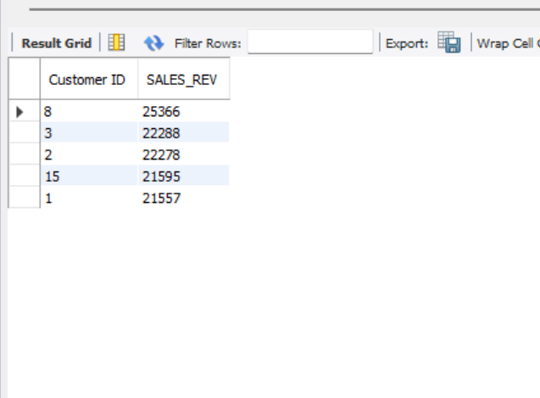
SQL - Output
Top 5 Customers by Sales Revenue

Slide 20
Q10. Analyzing SALES TRENDS BY DAY OF THE WEEK Walmart wants To analyze the sales patterns to determine which day of the week brings the highest sales
Solution:
WITH highestweekdaysalesCTE AS (
SELECT
Branch,
dayNAME(DATE) as day_name,
ROUND(SUM(TOTAL), 2) AS Highest_Sales,
RANK() OVER (PARTITION BY Branch ORDER BY SUM(TOTAL) DESC) AS Rank_TOTAL
FROM
walmart_sales
GROUP BY
Branch,
day_name)
Cont
SELECT
Branch,
day_name,
highest_sales
FROM highestweekdaysalesCTE
WHERE
Rank_TOTAL<2
order by
highest_Sales desc;

Slide 21
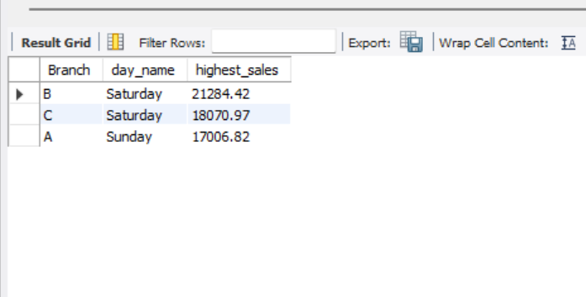
SQL - Output
Day of the week with Highest Sales by Branch

Slide 22
Here is the link to my video explanation

